Slide 1
Vrinda Store Dataset Store Data analysis is also called retail analytics
This Dataset is taken from Kaggle:-https://www.kaggle.com/datasets/anshika2301/vrinda-store-data-analysis

Slide 2
Objective Create a sales report. Understand the customer behavior and help to grow more sales. Analysis of all the important factors that affect the business.

Slide 3

Questions 1. Compare the sales and orders using a single chart. Which month got the highest sales and orders? 2 . Who purchased more men and women in 2022? 3. What are the different order statuses in 2022? 4. List the top 5 states contributing to the sales. 5. Relation between age and gender based on number of orders? 6. Which channel is contributing to maximum sales? 7. Highest selling Category? Etc.

Slide 4
1. Compare the sales and orders using a single chart. Which month got the highest sales and orders?
Month | Count of Order ID | Sum of Amount
Jan | 2702 | 1820601
Feb | 2750 | 1875932
Mar | 2819 | 1928066
Apr | 2685 | 1829263
May | 2617 | 1797822
Jun | 2597 | 1750966
Jul | 2579 | 1772300
Aug | 2617 | 1808505
Sep | 2490 | 1688871
Oct | 2424 | 1666662
Nov | 2383 | 1615356
Dec | 2384 | 1622033

Slide 5

2. Who purchased more men and women in 2022? Women purchased more then men.

Slide 6
3. What are the different order statuses in 2022?

Slide 7

4. List the top 5 states contributing to the sales.

Slide 8

5. Relation between age and gender based on number of orders?

Slide 9

6. Which channel is contributing to maximum sales?

Slide 10
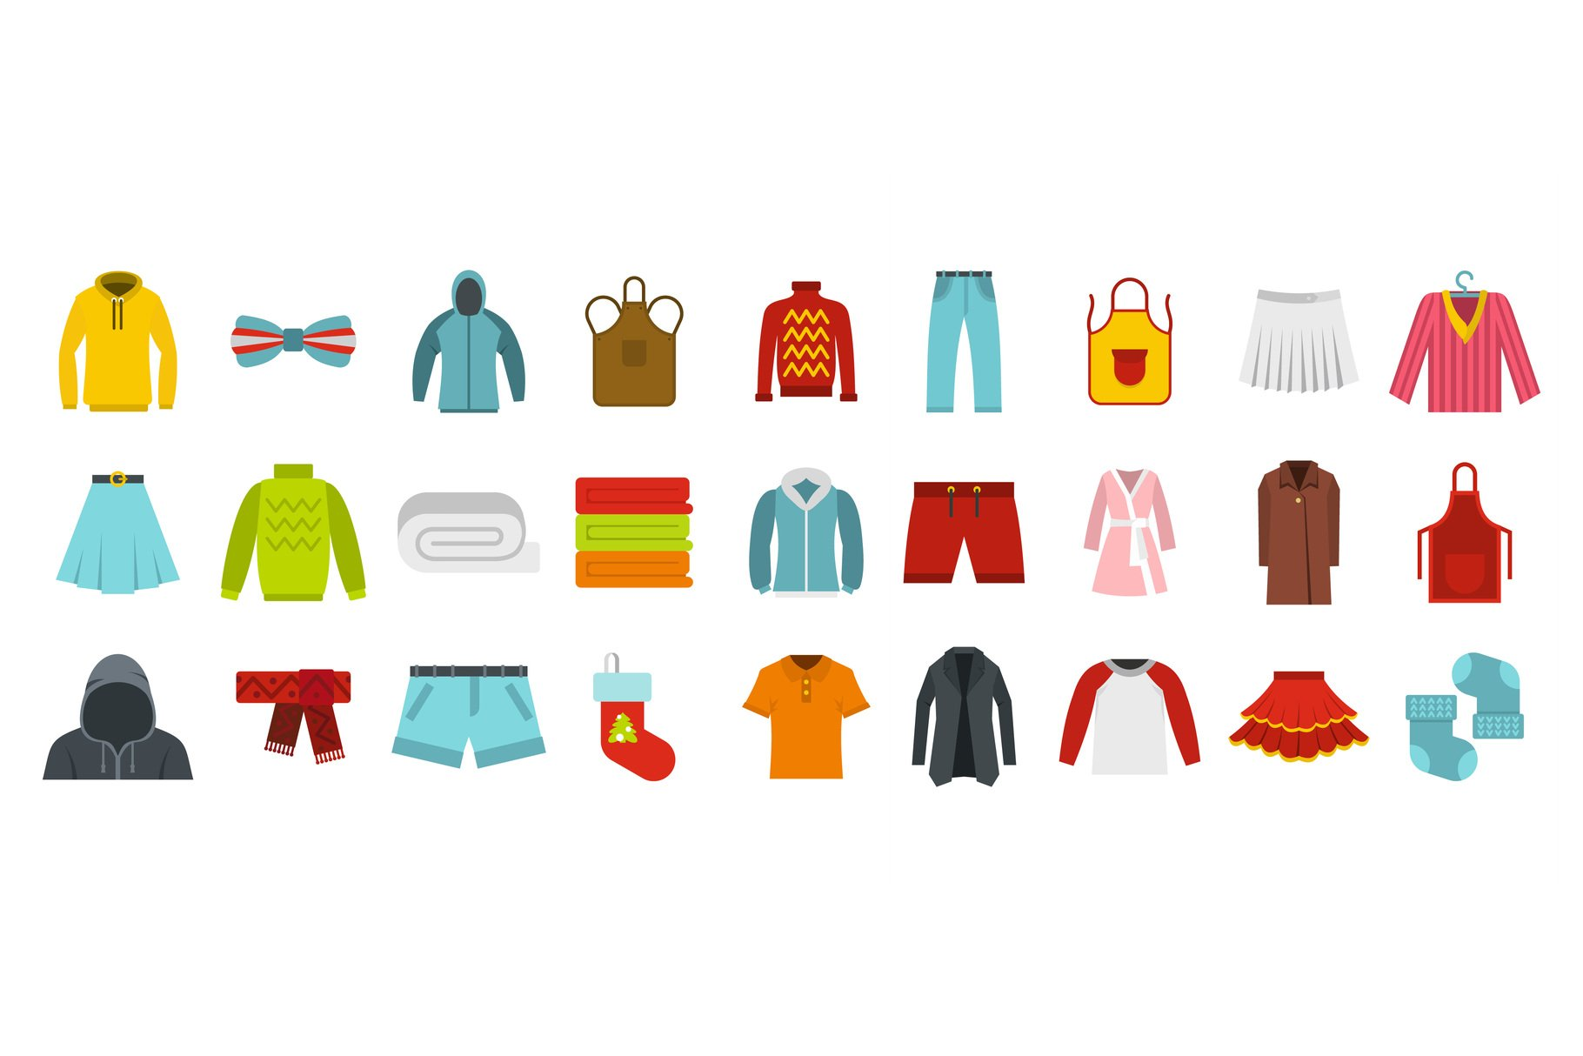
7. Highest selling Category? Etc.

Slide 11
Conclusion Target women customers of the age group (30-40) living in Maharashtra, Karnataka, and Uttar Pradesh by showing ads and offers available on Amazon, Flipkart, and Myntra. We should be focusing on Maharashtra, Karnataka and Uttar Pradesh because they are the top three states.

Slide 12
Thank you

